Slide 1

Keeping You Safe
At

Slide 2

British Values
There are 4 British Values
Democracy
Rule of law
Individual liberty
Mutual respect for and tolerance of those with different faiths and beliefs and for those without faith.
How do we promote British Values in school?

Slide 3

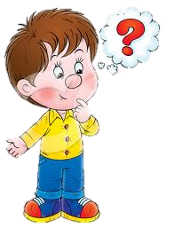
The Gates
Locked as soon as the day begins and stays locked until the end of the school day.
WHY?

Slide 4


The Fencing
Very high and always kept in good repair
Why?

Slide 5
Visitors
Badge Scanners
Where are they?
Why do we have them?
What is lockdown and when does it happen?

Slide 6

Several members of staff on each playground at playtime
Why?

Slide 7
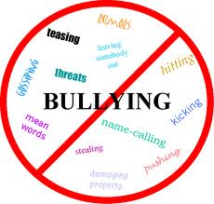

Building Positive Relationships
Anti-bullying Assemblies and Lessons
Kindness Leaders
PSHE lessons
PSHE as an enhancer for Enquiry
Online Safety lesson

Slide 8


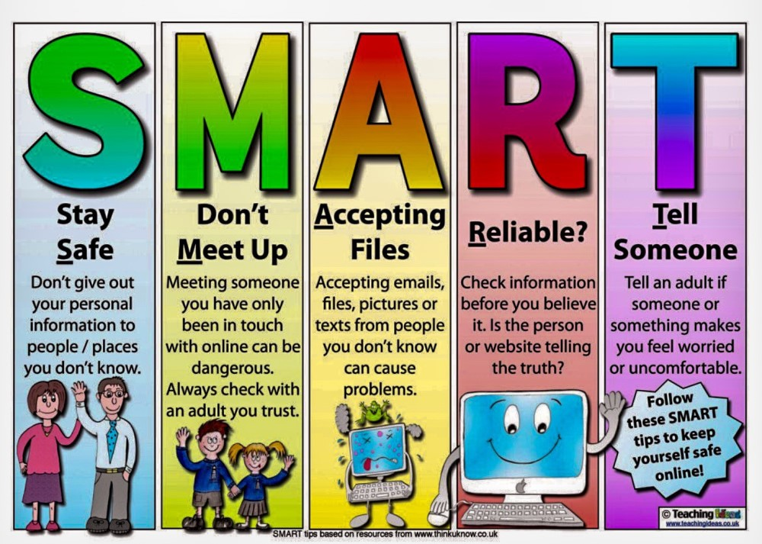
Online Safety
TOP TIPS

Slide 9
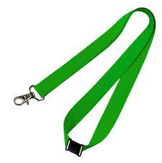
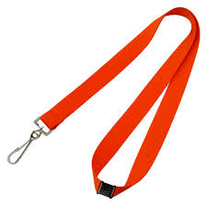

Lanyards
Who wears what
colour? Green? Red?
Why are they
worn?

Slide 10
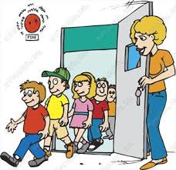

Fire Drill
Why do we carry out fire drills?
What do we need to make sure we do – as we leave the building and as we are lined up?

Slide 11

The staff are qualified First Aiders.

Slide 12

Who can you come and speak to if you have any concerns?

Slide 13
So Do We Keep You Safe at School?

